Slide 1
Determining Sex Based on Height, Weight, Drug Usage, and Smoke Usage
Machine Learning Fundamentals
Christopher Rha
1/22/2019

Slide 2
Questions
Before getting to my final question, I had a few that I wanted to test out.
Some examples would be:
Is there a correlation between smoking and drug usage?
What ethnicity has the most words in their essays?
Is it possible to predict the sex based on when they were last logged on?
I ultimately chose determining sex based on other factors because it sounded the most interesting.

Slide 3
Parsing the Data
It was a bit harder to understand the data for drug and smoke usage.
Height is easily understandable because it is just numbers.
Weight, Drug and smoke usage are strings so I had to assign numbers to the phrases chronologically according to how much they seemed to weigh or how much they smoked.
Additionally, their sex had to be mapped too; but that was just a 1 or 0 if they were female or male, respectively.

Slide 4
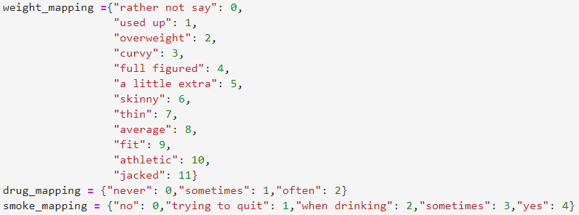
How Weight, Drug Usage, and Smoke Usage was Split

Slide 5
Classification
I chose to use the K Neighbors classification because it made the most sense to me.
Linear Regression would be difficult because of the multiple factors and no timeline.
Multiple Linear Regression and Neural Networks may work as well, I suppose I just did not understand them as much.

Slide 6
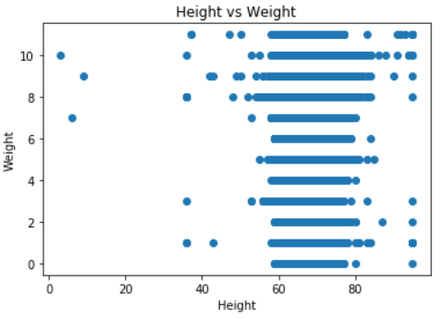
Complications
Before deciding my question, I play with the data a bit to see if I could find anything interesting.
I tried to find some way to use Linear Regression but there was a huge problem with independent variables, and string data types.

Slide 7
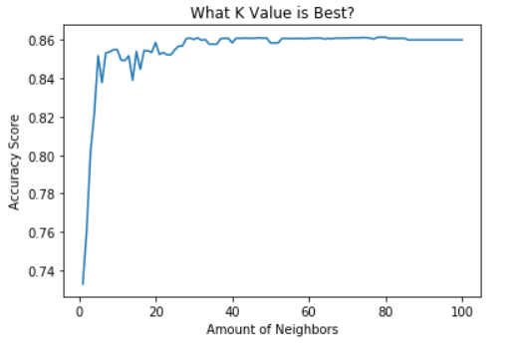
Using K Neighbors
At first I tried to see if it was possible to predict sex based off of only height and weight.
I found a reasonable guess as to what the k value should be and through trial and error, found the accuracy to be 86.11% at 31 neighbors.
Additionally, the program took around 21 seconds to run.

Slide 8
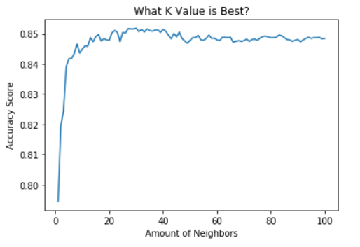
Using K Neighbors
Then, I thought what would happen if I add more data into the classification.
Here, I added drug usage and smoke usage.
Interestingly enough, the accuracy only peaked at 85.17% at 27 neighbors.
This was 0.94% less accurate than the last and took the same amount of time to run.
Maybe that data did more harm than good

Slide 9
Conclusion
With an 86.11% accuracy, yes, the program can decently predict a user’s sex.
However, I was very surprised at how drug usage and smoke usage had no benefit to the accuracy and even made it worse.
One answer I have to this conundrum is that adding those factors forced me to take out many users that did not respond to one or more of these questions. Height and weight allowed me to test 54k users while those factors only gave me 36k.
My next step will be to map the user’s ethnicity and combine it with the existing data. Hopefully this will increase the accuracy.
If there was another category that I could have from the users, it would be their favorite color. I would be interested to see how that would affect results.

